Slide 1
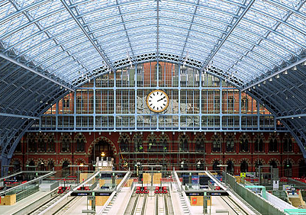
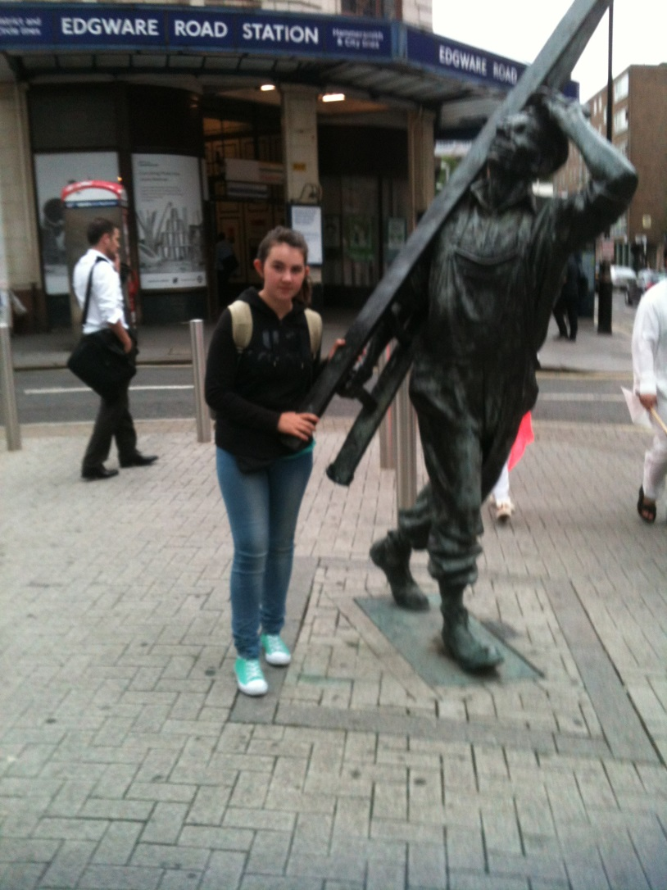
My trip to London
I went to London with my grandmother last summer.
We took the RER from Massy to Gare du Nord and we took the Eurostar from Gare du Nord to London (St Pancras Station).
When we arrived in St Pancras, we had to look for our flat to leave our luggage.
After a quick rest we went out shopping for food at
the local Mark&Spencer’s shop.
After that we went out again to get to know the
district of Marylborne. I saw Sherlock Holme’s House at
221B Baker Street.

Slide 2
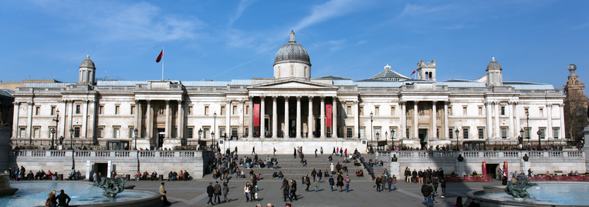
Day two: Big Ben, Whitehall and National gallery
In the morning, we saw Big Ben, The houses of Parliament, Westminster bridge. We walked along Whitehall up to Trafalgar square with Nelson’s column and the National gallery.
I visited the National gallery, a few rooms. There are some beautiful paintings (By Tuner and Van Gogh).
At noon we ate fish and chips in a restaurant. It was too good !
After we took the tube in Oxford Station back home.

Slide 3
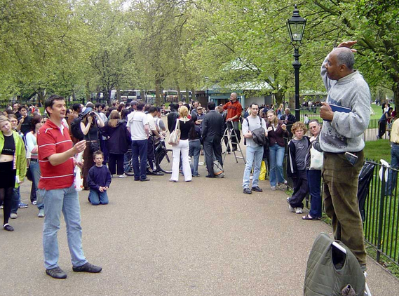
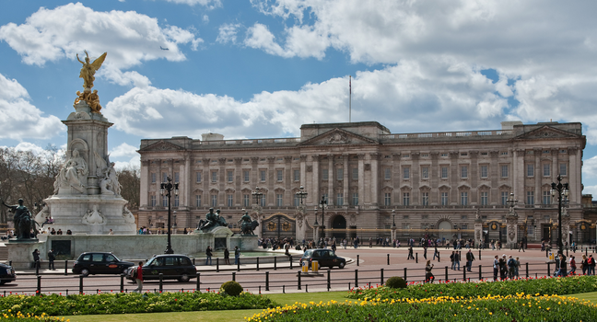
Day three: Buckingham palace and Hyde Park
We took the tube to Charing Cros.
Then we walked along the Mall to Buckingham Palace, and there were a lot of people walking in the same direction.
We stopped to watch the guards at St James’s Palace and at Buckingham Palace to see the changing of the guard. It takes place at 11 o’clock every two days.
After that, we walked up Constitution Hill to Hyde Park corner and Wellington Arch.
And we walked all the way to the famous Speaker’s Corner. We had our picnic there and we listened to funny conversations.
We took the tube back home.

Slide 4
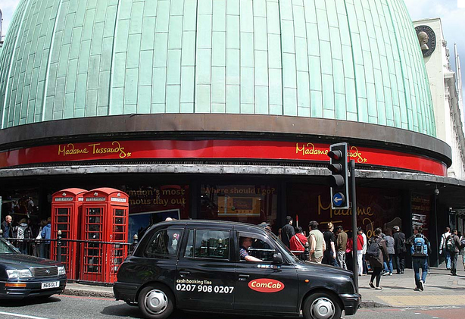
Day four: Madam Tussaud and the British museum
We took the tube at Edgware Rd Station.
We were at Madam Tussaud’s early in the morning. At the begining it was funny, I took a lot of photos of famous people.
At noon for lunch time we had a traditinal breakfast. I love it ! (It was composed of eggs, bacon, mushrooms, sausages and toast)
After our meal we walked down to Oxford Station. We walked past Selfriges huge building. We took the tube at Oxford Circus to Holborn for the British Museum. We saw mommies and the Rosetta stone.
When we went out of the museum we walked up to Marble Artch along Oxford street before getting back home.

Slide 5
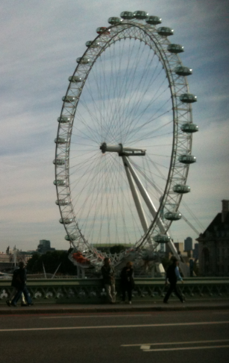
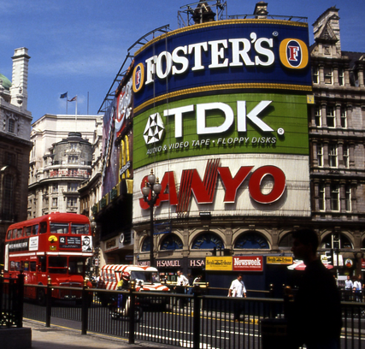
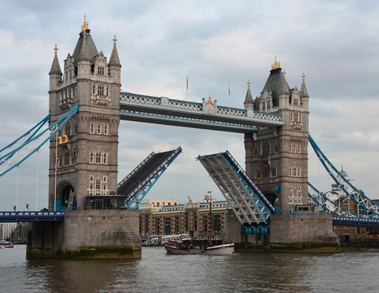
Day five: Bus tour,Tower of London, London Eye and Picadilly Circus
A coach picked us up at 7:20 am, we went to Victoria Station where we got on our bus for a Bus Tour. The bus took us around as far as the Tower of London and Tower Bridge.
We got off the bus there at the Tower and got on a boat. The boat took us from the Tower to Embankment. We got off the boat and got on our bus to St. James’s Palace for the changing of the guard there and at Buckingham Palace.
Than we got on another bus to the Tower of London.
We ate fish and chips before visiting the Tower. After visiting the Tower we walk to Tower Bridge. On the way, we could see the two parts of the Bridge going up to let a boat pass.
After that, we had some free time so we decided to go back to the London Eye.
I had a great view of London. After that we walked through Trafalgar Square to Picadilly Circus to see the lights.

Slide 6
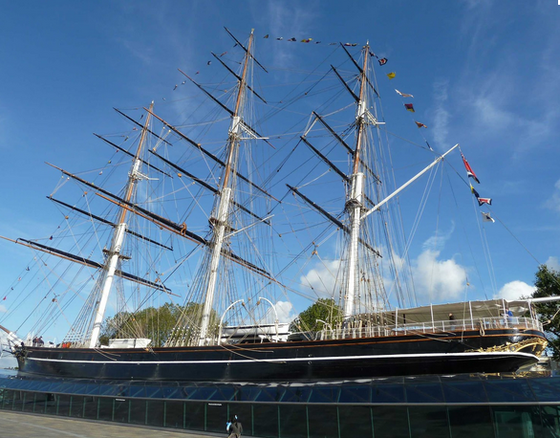
Day six: Museum of London and Greenwich
We took the tube at Edgware Rd to St Paul’s. We visited the Museum of London. (history of London)
Afterwards we decided to try the DLR (Dockland Light Railway) to go to Greenwich to see the Cutty Sark. It was a famous clipper in the 19th century.
It was dark when we travelled back on the DLR and the view was very nice with all the lights on.
It was the end of our trip to London.

